Slide 1
Road Safety in the Greater London Area
Group Project Presentation
By Angad Dhillon, Camille Velarde, Christina Leung & Gurpreet Doal

Slide 2
Introduction
Goal: Visualize London’s vehicular accidents and extract meaningful insights that can inform safety measures, urban planning, and policy decisions in the future
Understanding of accident landscape, exploring factors such as severity, location, population, and casualty mode
The significance of road safety and potential to contribute to the well being of community drove out team to choose this topic

Slide 3
Technologies Used
Python (to clean and export data)
MongoDB (to store our data)
Flask (to create framework for API’s)
JavaScript & Chart.js (to visualize data)
HTML & CSS ( as basic skeleton of webpage)

Slide 4

Project Architecture

Slide 5

Data Sources
Accidents API api route: /api/v1.0/accidents

Slide 6

Data Sources
London Borough GeoJSON Api Route: /api/v1.0/boroughs

Slide 7
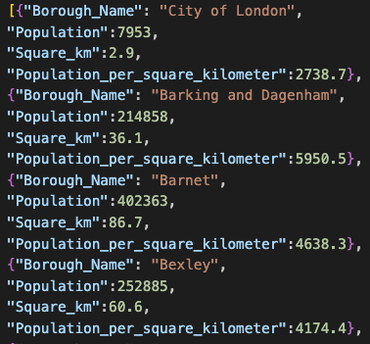
Data Sources
London Population and Area api route: /api/v1.0/population

Slide 8
Dashboard Views
Map of London
Total Accidents Bar Graph by Borough
Casualties Pie Chart by Types

Slide 9
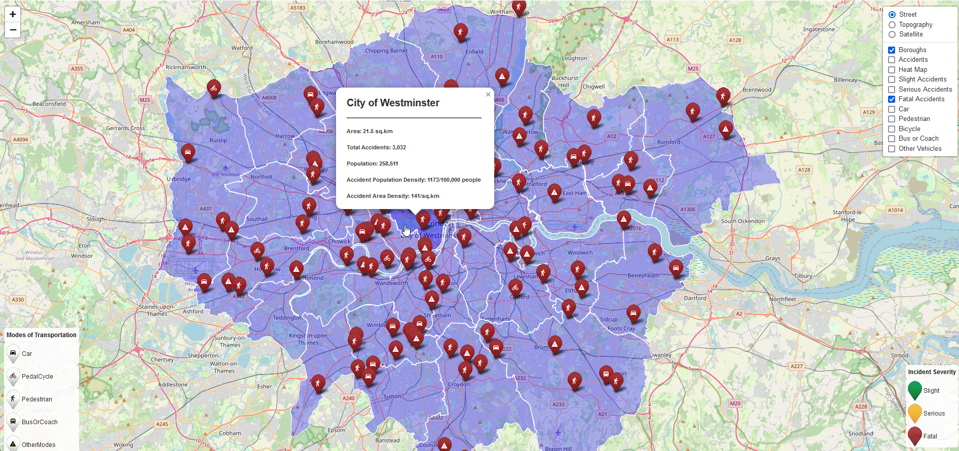
Map of London Demo

Slide 10
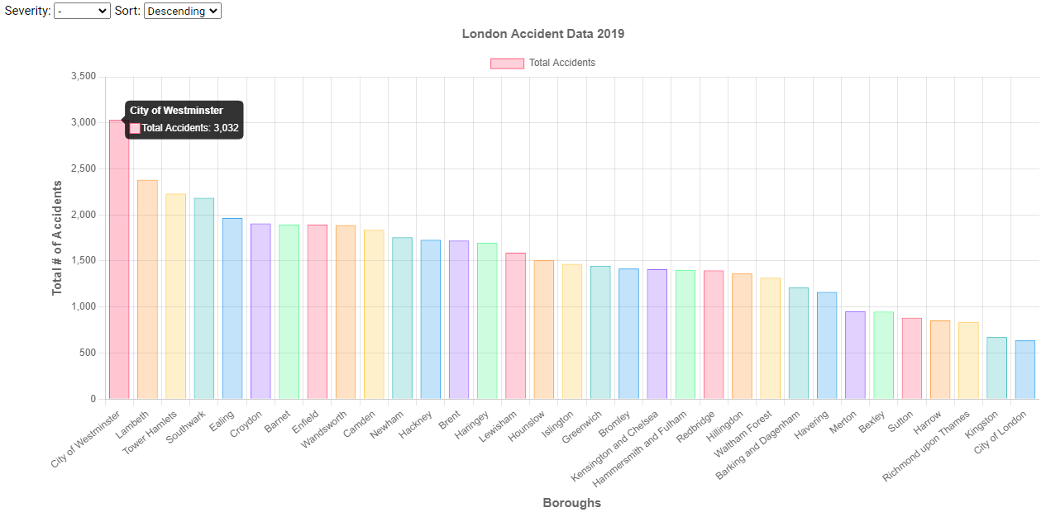
London Accident Data by Borough Demo
 | Top 5 Boroughs with Highest Total # of Accidents
Rank | Borough | Total # of Accidents
1 | City of Westminster | 3032
2 | Lambeth | 2382
3 | Tower Hamlets | 2232
4 | Southwark | 2186
5 | Ealing | 1966

Slide 11
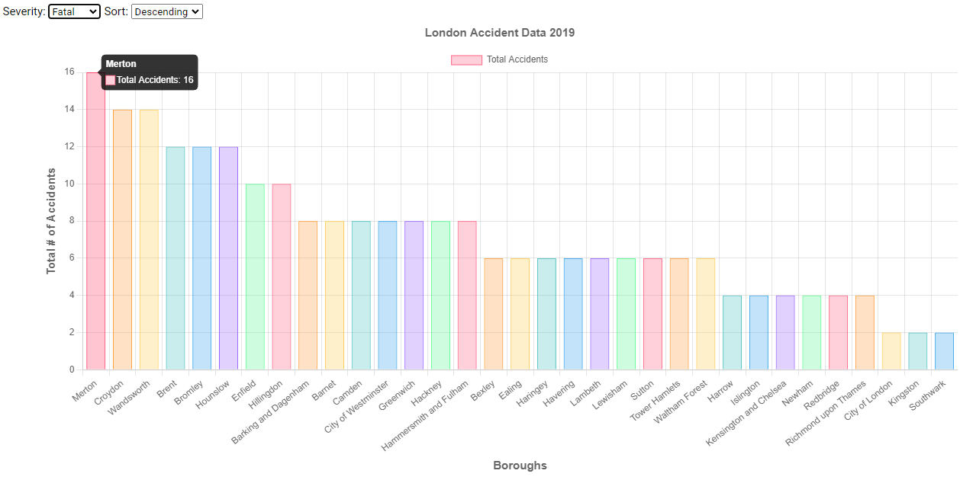
London Accident Data by Borough Demo
 | Top 5 Boroughs with Highest Total # of Fatal Accidents
Rank | Borough | Total # of Accidents
1 | Merton | 16
2 | Croydon, Wandsworth | 14
3 | Brent, Bromley, Hounslow | 12
4 | Endfield, Hillingdon | 10

Slide 12
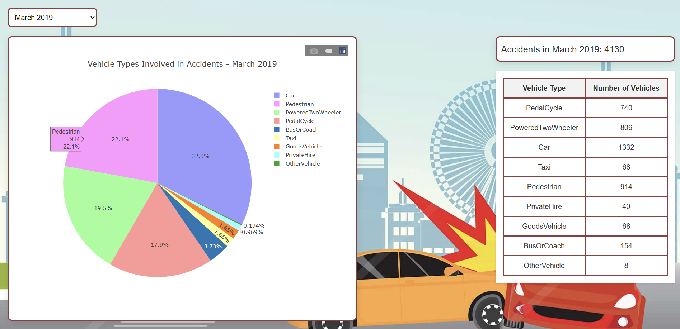
London Accident Data by Casualty type Demo

Slide 13
Data Analysis
Bromley has the lowest accidents/sq.km of 9. Bromley - 150 sq.km
City of London has the highest with 220 accidents/sq.km. City of London - 2.9 sq.km
City of Westminster has highest accidents per 100,000 people - 1173
Harrow has lowest accidents per 100,000 people - 330

Slide 14
Data Analysis
 | Top 5 Boroughs with Highest Total # of Accidents
Rank | Borough | Total # of Accidents
1 | City of Westminster | 3032
2 | Lambeth | 2382
3 | Tower Hamlets | 2232
4 | Southwark | 2186
5 | Ealing | 1966
 | Top 5 Boroughs with Highest Total # of Fatal Accidents
Rank | Borough | Total # of Accidents
1 | Merton | 16
2 | Croydon, Wandsworth | 14
3 | Brent, Bromley, Hounslow | 12
4 | Endfield, Hillingdon | 10

Slide 15
Data Analysis
Peak Accidents: Most in November (4,694), October (4,594), and June (4,544)
Fewest Accidents: April (3,760), February (3,782), January (3,790)
Vehicle Involvement: Dominated by cars (16,450 accidents), followed by pedestrians (10,472), powered two-wheelers (10,370), and cyclists (9,088). Lesser involvement of buses and goods vehicles.

Slide 16
Conclusion
Inconclusive evidence to relate months with accidents
Other factors could include road maintenance
Weather
More car safety measures as cars are involved with nearly 50% of the accidents as well as safety measures for pedestrians as they are constantly exposed to the road
However, most accidents are only slight accidents, with an 86% of the accidents being only slight accidents
Accident density increases closer to the centre of the city

Slide 17
Q&A
Open floor for question and discussions.

